Slide 1
Fractal Blasters Media Player

Slide 2
Product Line Characteristics
Plays audio files
Runs using Windows and .NET Framework
Plug-in Based
Keeps a media library of music stored on the user’s computer

Slide 3
Commonalities
Will be able to decode and play .wav and .raw file forms
Will be able to utilize basic media controls (play, pause, stop, back, forward, volume, position)
Accept controls from user via mouse
Output audio through variable devices
Support progressing playlist
The suite will support a built-in library feature

Slide 4
Variabilities
The suite may or may not support various file extensions (including mp3, wma).
The suite may or may not be capable of sorting music by category
The suite may or may not support saving and loading playlists.
The suite may or may not have a visualizer packaged with it.
The packaged visualizer may have a large range of available features/styles, or fewer
The suite may or may not support multiple playlists being open at the same time.

Slide 5
Decision Model
Parameter | Meaning | Value Set | Constraints | Binding Time | Modules
P1: SFileFormats | What kinds of files can be played by the suite | wav, ogg, mpc, flac, TTA, aiff, raw, au, gsm, dct, vox, mmf, mp3, aac, mp4, wma, artac, .wav, ra&rm, dss, msv, dvf, m4p, iklax, mxp4, 3gp, amr, and awb. | Any combination of the value set | Spec | Input
P2: categorySortable | Whether or not a list of songs can be sorted by the categories Title/ Artist/ Album/ Time/ etc | Boolean, True/ False |  | Spec | Library Form
P3: sPlaylists | Whether or not the user is allowed to save and load playlists | Boolean, True/ False |  | Spec | Playlist Form
P4: VisEnabled | Whether or not the visualizer is included in the suite | Boolean, True/ False |  | Spec | Playback Control Form

Slide 6
Decision Model (2)
Parameter | Meaning | Value Set | Constraints | Binding Time | Modules
P4.1: visLevel | What level of visualization is available | Equalizer only, Equalizer and Visualizer, Equalizer and Visualizer with plugins. [0,1,2] | Only valid if visualizations enabled | Spec | Playback Control Form
P5: multiPList | Whether or not the user is allowed to have multiple playlists open simultaneously | Boolean, True/ False |  | Spec | Playlist Form
P6: skinEn | Whether or not the user is able to use plugin based skins for the player | Boolean, True/ False |  | Spec | Playback Control Form

Slide 7
Fractal Blasters Architecture
Modules are divided into three categories:
  File Management
  User Interface
  Wave Processing
Additional code will be implemented for installation, startup, and common interfaces

Slide 8
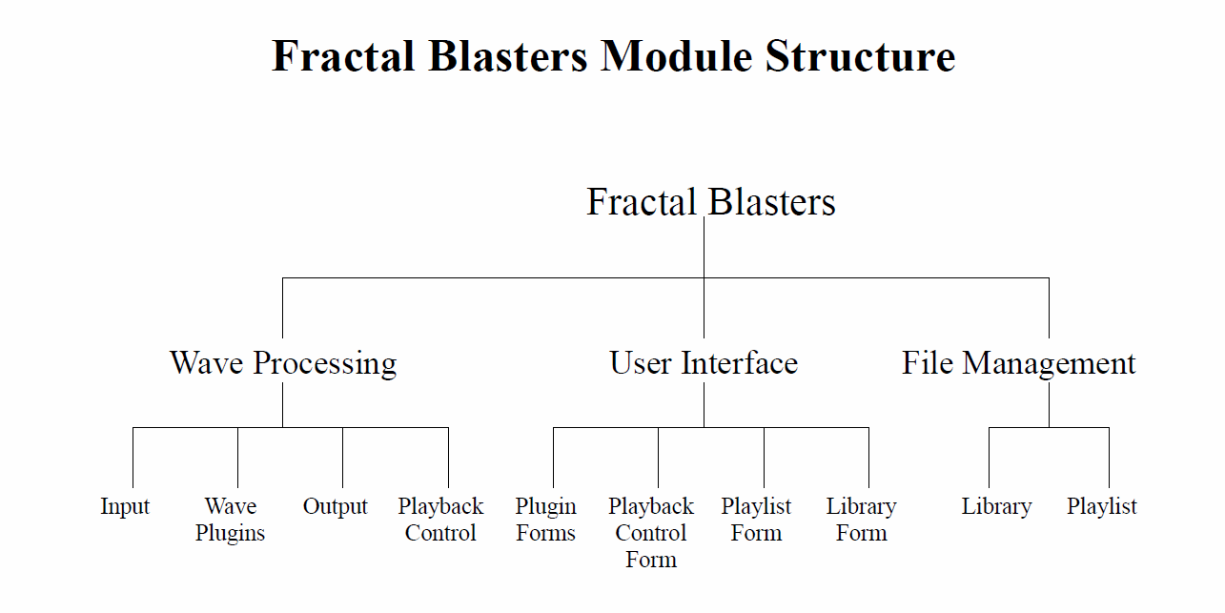

Slide 9
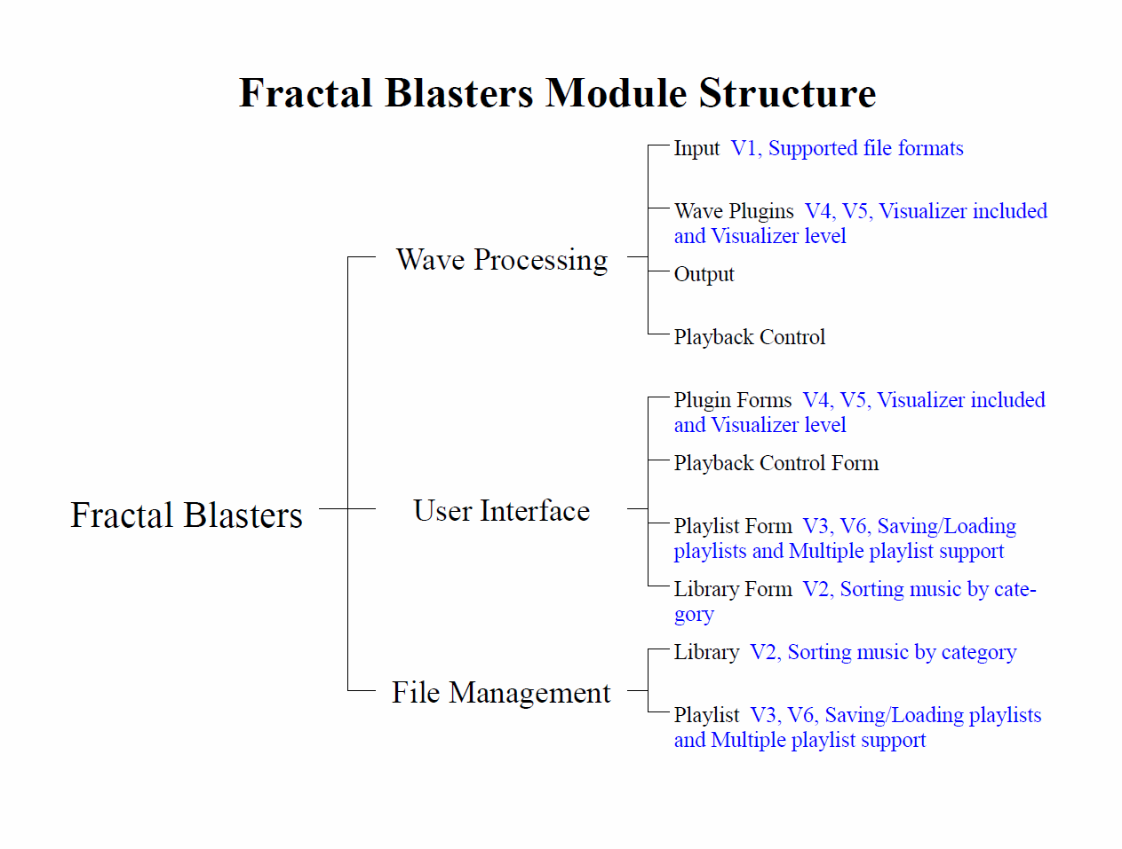

Slide 10
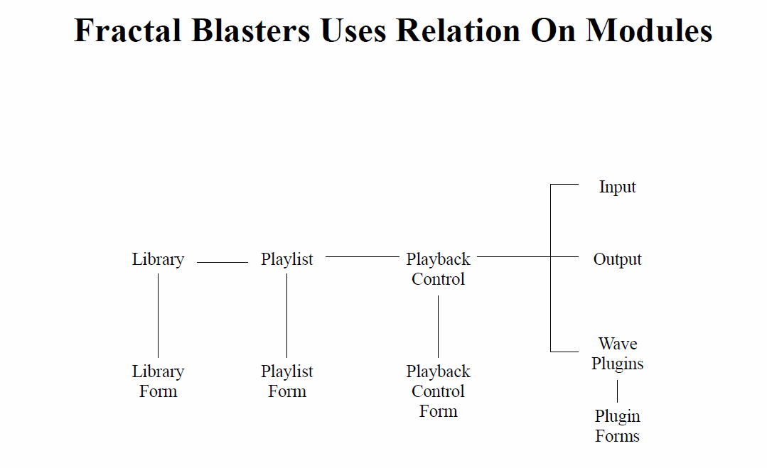

Slide 11
Development – Decoding/Output
3rd Party Library – FFMPEG
  Supports all file formats
  Provides PCM audio stream
Windows API
  Waveform Audio Functions
  Custom Audio Buffers

Slide 12
Development – Library / Playlist
Library
  Automatically searches your media folder
  Multiple view-styles
Playlists
  Plugin Based
  Support for the popular M3U

Slide 13
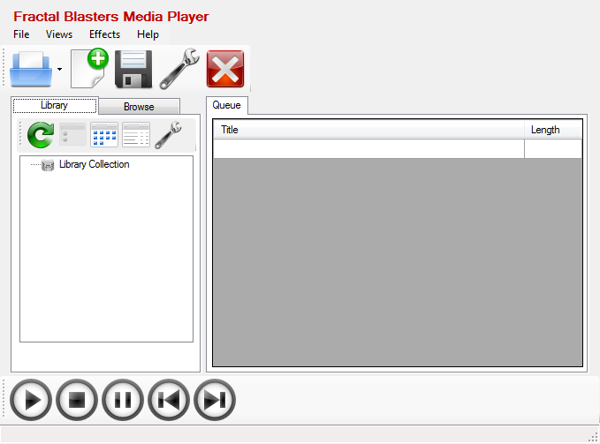
Screenshots

Slide 14
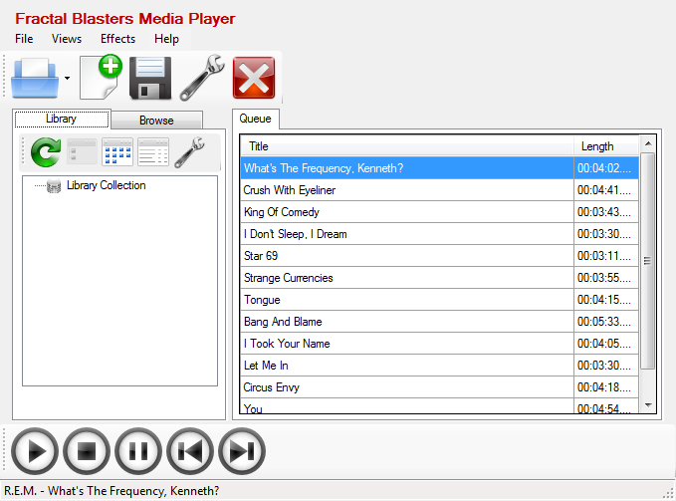
Screenshots

Slide 15
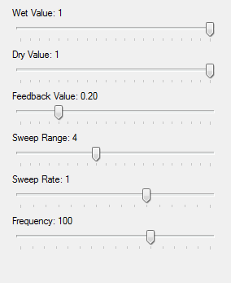
Screenshots

Slide 16
Timeline
• 2/14/11 – Finish core engine functionality (basic controls & a list of supported formats).
• 3/06/11 – Finish playlist and library plugins.
• 3/8/11 – Most forms need to be turned in by.
• 4/01/11 – Finish visualizer and smart playlists.
• 4/14/11 – Finish all testing documents.
• 4/20/11 – Be completely bug free
3/7/11

Slide 17
Risks
• We fail to perfect all the pieces of our project
• A member of our group fails to complete his section of the project.
• We make some inaccurate estimates on our capabilities.
• We fail to meet all our dates.
3/7/11

Slide 18
Risk Mitigation
• In order to ensure we finish the most possible, we finish everything on a scale of importance.
• By spreading the goals of the group across as many people as possible, the failure of a single person can be picked up by everyone else working together.
• By trying to finish everything ahead of time, we can limit the affect of inaccurate time and capability estimates for our team.
3/7/11

